Slide 1
Design and Simulation of FIFO Buffer
M1
0
1
3
.
.
62
M2
2
63
63
0
clk2
clk1
62
1
rd_en
wrt_en
FIFO Buffer
61
2
.
buf_out
buf_in
.
.
.
.

Slide 2
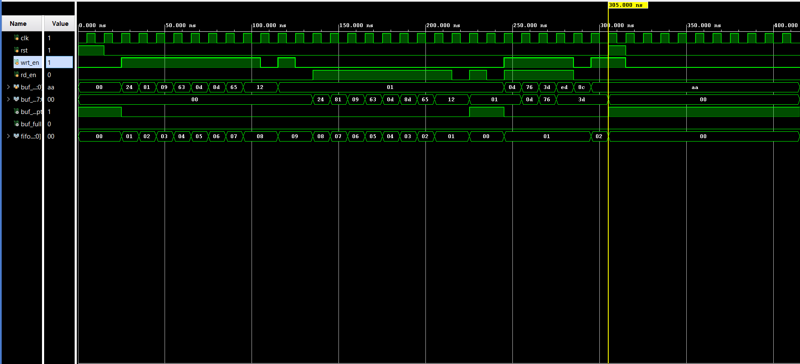

Slide 3
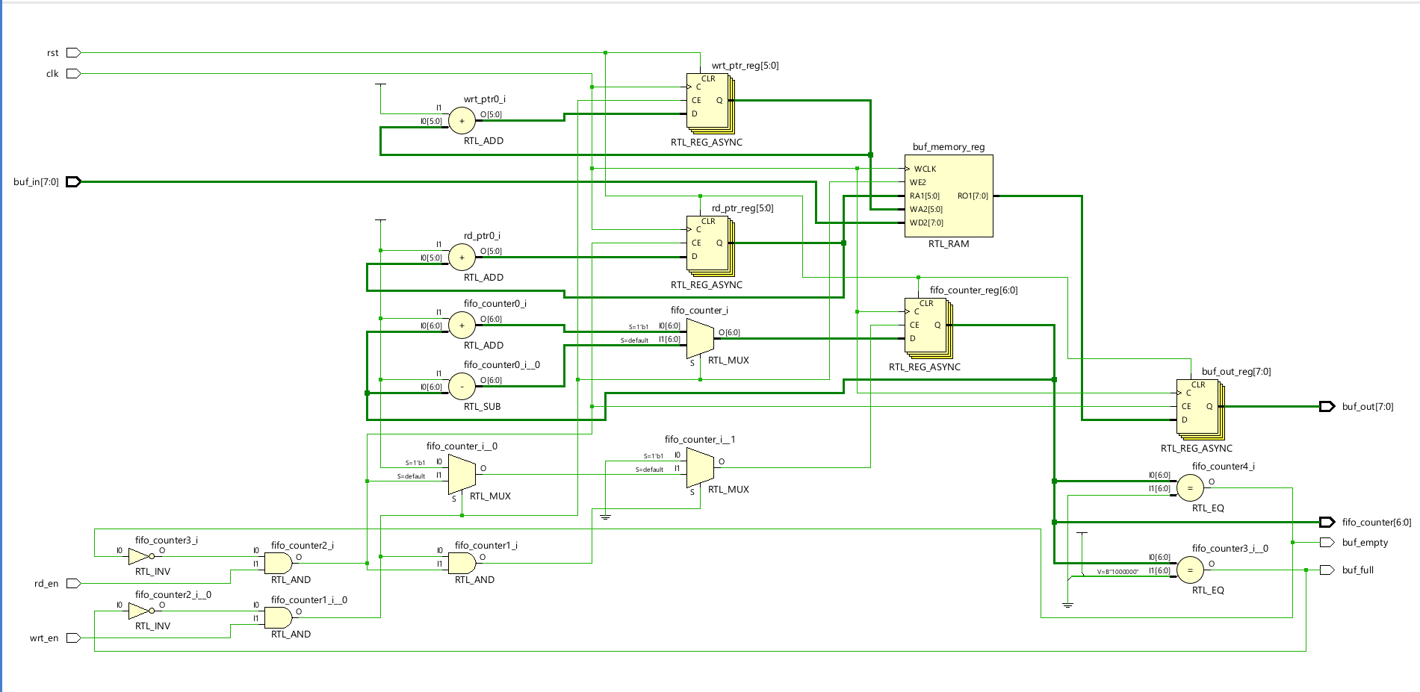

Slide 4
